Slide 1
Wrapper Class
Class representation of primitive types
Java is Object Oriented and every data type should be a Class
int -> Integer, short -> Short, long -> Long, byte ->Byte
boolean -> Boolean, char -> Character
float -> Float, double -> Double
Wrapper classes are immutable and they have methods to operate on data types
Integer age = new Integer(45);
int anotherAge = Integer.parseInt(“54”);
Boolean rainingToday = new Boolean(false);
AutoBoxing : converting primitive types to objects and objects to primitive types automatically
Float price = 32.5f;
boolean gender = Boolean.FALSE;
Wrapper classes are immutable :
Basically once they are created, they are not changeable
There will not be set methods in these Object (more about how to do this after we learn Object Encapsulation)
Wrapper Objects can have null values

Slide 2
Enumerations (enum)
Enum is a special type of data type (class) that has finite set of values
Eg:- color, gender, direction etc
enum Color{ RED, BLUE, GREEN;}
enum Gender{ MALE, FEMALE;}
enum Direction{ NORTH, EAST, WEST, SOUTH}
enum’s can be used as a data types like following
class Person{
Color color = Color.RED;
Gender gender = Gender.MALE;
}

Slide 3
String and its usage
String is a Java provided Class that can represent an array (or group) of characters
String is widely used in Java Programming and can be used for managing names
String professorName = new String(“Siva);
String universityName = new String(“NEU”);
String can also be created using a literal
String studentName = “Kerwin”;
Above use of String definition makes us believe that String is aligned with a primitive date type
String is a more convenient class than array of characters
String location =“Seattle”;
char locationArray[] = new char[] {‘S’,’e’,’a’,’t’,’t’,’l’,’e’};
String has a lot of convenient methods
String street =“King st”;
int length = street.length(); //7
boolean b = street.contains(“st”)’ //true
String s = street.substring(0,4); //”King”
String objects are immutable
Strings can be concatenated to create new Strings
String name = “Siva” + “ “+”Dosapati”;
Siva
“ “
Dosapati
name
Siva Dosapati

Slide 4
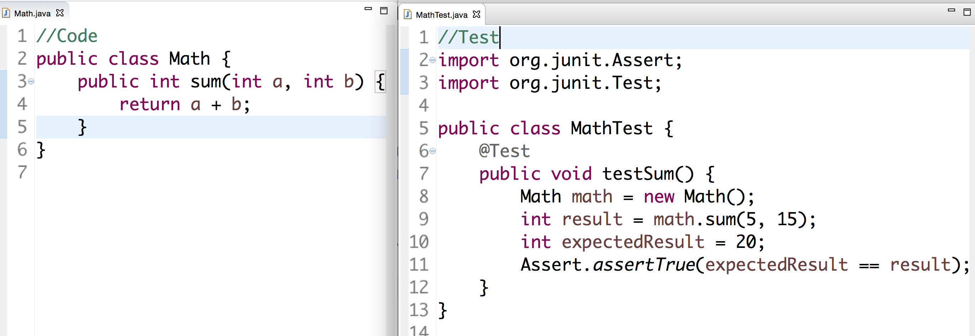
TDD
TDD : Test Driven Development
Testing is a mechanism to certify a piece of logic or code or functionality
Testing can be manual (System.out.println) or Automated
What if Test can also be a code
Junit is a mechanism to test the Java code
TDD is a philosophy where we write the Test first before writing code
TDD helps catch critical bugs and ensures that other engineers don’t create bugs
Tests act like Insurance for the Code

Slide 5
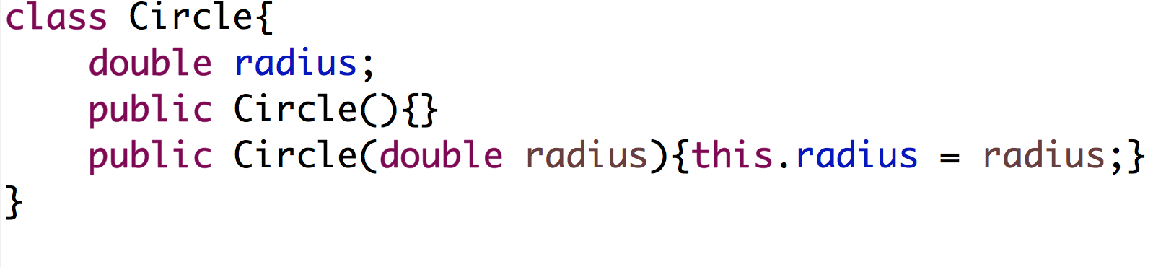
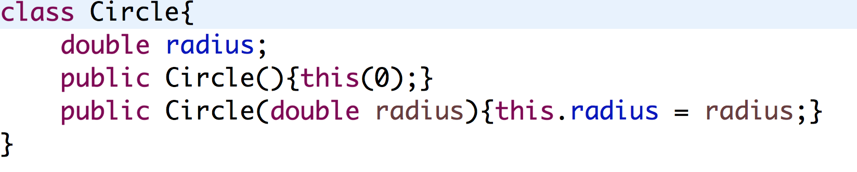
Constructor
Constructor is a behavior that gets invoked when an object is created
Constructors can have parameters or no parameters
Java provides a default constructor
Constructors don’t return any value
“this” is a special keyword that can be used to access instance variables in the class – it is helpful to use when the name of the parameter is same as instance variable
One constructor can be invoked from another constructor using this()

Slide 6
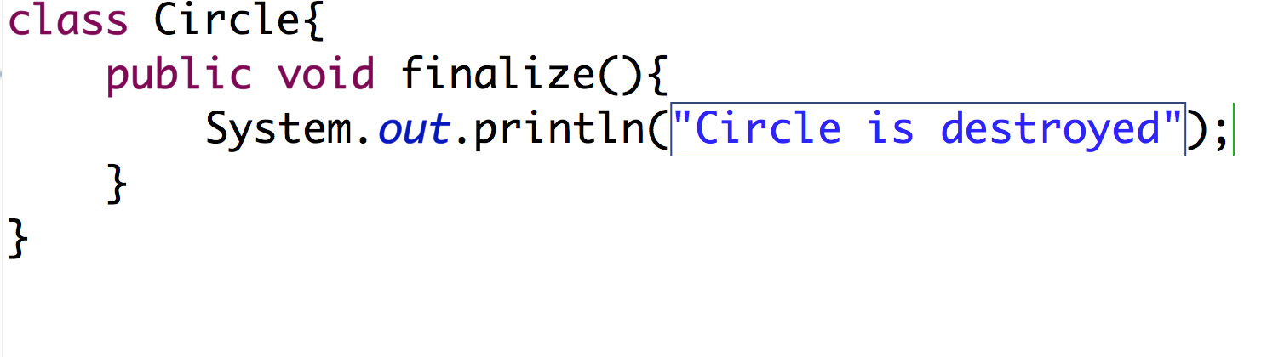
Destructor
Destructor gets invoked when an object is garbage collected or not referenced by any pointer
Any specific logic to be executed when destroying the object needs to be written in finalize() method
However, it’s not guaranteed that logic will be executed immediately after an Object is destroyed
Garbage collector can be forced to execute using System.gc() and that would result the destructor
Good part of Java – No need to free the memory when an object is destroyed.
Java will automatically free the space (Garbage Collector)

Slide 7
Encapsulation
Encapsulation is a mechanism to protect the access to Object’s state or methods
This is the main principle of OOP that separates from Procedural programming where data is globally accessible
Data is encapsulated through different scopes
public scope : access to the methods in the class it is defined and other classes
public int age = 25;
protected scope : access to the methods in the class it is defined and child classes of the class (more after inheritance)
protected String name = “NEU”;
default scope : access to the methods in the class it is defined and other classes in the package
Float price = 76.5f;
private scope : access to the methods in the classes it is defined in the class. No other class can access this state
private boolean gender = false;
Methods in the class can also be encapsulated depending on the access pattern
Class Student{
private String name;
public float gpa;
protected int age;
public void speak(){}
private void memorizeLecture(){}
protected void answerQuestion(){}
}
Data types in a class should be private.
A public getter method (aka accessor) should be defined in a class to access the state
A public setter method (aka mutator) should be defined in a class to mutate the state.
These 2 methods protect the access to state..

Slide 8
Abstraction
Abstraction is focusing on the outcome but not on how the outcome is achieved
Abstraction in Classes is achieved through methods
Goal of Abstraction is identify the set of behaviors and invoke them as against coding them
class Professor{
public void teach(){
Course course = findCourse();
prepareAtHome(course);
String content = course.getContent();
teachCourseToStudents(course, getStudents());
}
private Course findCourse(){}
Private void prepareAtHome(Course course){}
private void teachCourseToStudent(Course course, Students students){}
}

Slide 9
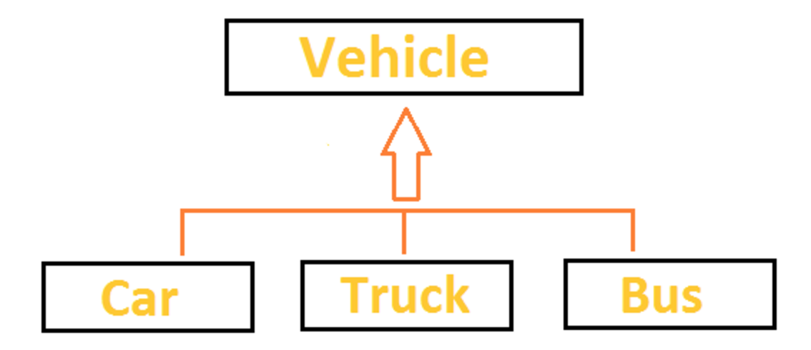
Inheritance
Inheritance is a mechanism to reuse the code written in one class by another class
Inheritance is a relation between two classes. For eg:- Car is a Vehicle, Bus is a Vehicle

Slide 10
Terminology
Inheritance is a fundamental Object Oriented concept
A class can be defined as a "subclass" of another class.
The subclass inherits all data attributes of its superclass
The subclass inherits all methods of its superclass
The subclass inherits all associations of its superclass
The subclass can:
Add new functionality
Use inherited functionality
Override inherited functionality
superclass:
Person
- name: String
- dob: Date
subclass:
Employee
- employeeID: int
- salary: int
- startDate: Date

Slide 11
What really happens?
When an object is created using new, the system must allocate enough memory to hold all its instance variables.
This includes any inherited instance variables
In this example, we can say that an Employee "is a kind of" Person.
An Employee object inherits all of the attributes, methods and associations of Person
Person
name = "John Smith"
dob = Jan 13, 1954
Person
- name: String
- dob: Date
Employee
name = "Sally Halls"
dob = Mar 15, 1968
employeeID = 37518
salary = 65000
startDate = Dec 15, 2000
is a kind of
Employee
- employeeID: int
- salary: int
- startDate: Date

Slide 12
Inheritance in Java
Inheritance is declared using the "extends" keyword
If inheritance is not defined, the class extends a class called Object
public class Person
{
private String name;
private Date dob;
[...]
Person
- name: String
- dob: Date
public class Employee extends Person
{
private int employeID;
private int salary;
private Date startDate;
[...]
Employee
- employeeID: int
- salary: int
- startDate: Date
Employee anEmployee = new Employee();

Slide 13
Inheritance Hierarchy
Each Java class has one (and only one) superclass.
C++ allows for multiple inheritance
Inheritance creates a class hierarchy
Classes higher in the hierarchy are more general and more abstract
Classes lower in the hierarchy are more specific and concrete
There is no limit to the number of subclasses a class can have
There is no limit to the depth of the class tree.
Class
Class
Class
Class
Class
Class
Class
Class

Slide 14
The class called Object
At the very top of the inheritance tree is a class called Object
All Java classes inherit from Object.
All objects have a common ancestor
This is different from C++
The Object class is defined in the java.lang package
Examine it in the Java API Specification
Object

Slide 15
Constructors - Inheritance
Classes use constructors to initialize instance variables
When a subclass object is created, its constructor is called.
It is the responsibility of the subclass constructor to invoke the appropriate superclass constructors so that the instance variables defined in the superclass are properly initialized
Superclass constructors can be called using the "super" keyword in a manner similar to "this"
It must be the first line of code in the constructor
If a call to super is not made, the system will automatically attempt to invoke the no-argument constructor of the superclass.

Slide 16
Constructors - Example
public class BankAccount
{
private String ownersName;
private int accountNumber;
private float balance;
public BankAccount(int anAccountNumber, String aName)
{
accountNumber = anAccountNumber;
ownersName = aName;
}
[...]
}
public class OverdraftAccount extends BankAccount
{
private float overdraftLimit;
public OverdraftAccount(int anAccountNumber, String aName, float aLimit)
{
super(anAccountNumber, aName);
overdraftLimit = aLimit;
}
}

Slide 17
Method Overriding
Subclasses inherit all methods from their superclass
Sometimes, the implementation of the method in the superclass does not provide the functionality required by the subclass.
In these cases, the method must be overridden.
To override a method, provide an implementation in the subclass.
The method in the subclass MUST have the exact same signature as the method it is overriding.

Slide 18
Method overriding - Example
public class BankAccount
{
private String ownersName;
private int accountNumber;
protected float balance;
public void deposit(float anAmount)
{
if (anAmount>0.0)
balance = balance + anAmount;
}
public void withdraw(float anAmount)
{
if ((anAmount>0.0) && (balance>anAmount))
balance = balance - anAmount;
}
public float getBalance()
{
return balance;
}
}

Slide 19
Method overriding - Example
public class OverdraftAccount extends BankAccount
{
private float limit;
public void withdraw(float anAmount)
{
if ((anAmount>0.0) && (getBalance()+limit>anAmount))
balance = balance - anAmount;
}
}

Slide 20
Object References and Inheritance
Inheritance defines "a kind of" relationship.
In the previous example, OverdraftAccount "is a kind of" BankAccount
Because of this relationship, programmers can "substitute" object references.
A superclass reference can refer to an instance of the superclass OR an instance of ANY class which inherits from the superclass.
BankAccount anAccount = new BankAccount(123456, "Craig");
BankAccount account1 = new OverdraftAccount(3323, "John”,1000.0);
BankAccount
name = "Craig"
accountNumber = 123456
anAccount
OverdraftAccount
name = "John"
accountNumber = 3323
limit = 1000.0
account1

Slide 21
Polymorphism
In the previous slide, the two variables are defined to have the same type at compile time: BankAccount
However, the types of objects they are referring to at runtime are different
What happens when the withdraw method is invoked on each object?
anAccount refers to an instance of BankAccount. Therefore, the withdraw method defined in BankAccount is invoked.
account1 refers to an instance of OverdraftAccount. Therefore, the withdraw method defined in OverdraftAccount is invoked.
Polymorphism is: The method being invoked on an object is determined AT RUNTIME and is based on the type of the object receiving the message.

Slide 22
Final Methods and Final Classes
Methods can be qualified with the final modifier
Final methods cannot be overridden.
This can be useful for security purposes.
public final boolean validatePassword(String username, String Password)
{
[...]
Classes can be qualified with the final modifier
The class cannot be extended
This can be used to improve performance. Because there an be no subclasses, there will be no polymorphic overhead at runtime.
public final class Color
{
[...]

Slide 23
Static Variables
Static means “pertaining to the class in general”, not to
an individual object
A variable may be declared (outside of a method)
with the static keyword:
E.g. static int numTicketsSold;
There is one variable numTickets for the class not one per object!!!
A static variable is shared by all instances (if any).
All instances may be able read/write it
A static variable that is public may be accessed by:
ClassName.variableName
E.g. Math.PI

Slide 24
Static Methods
A method may be declared with the static keyword
Static methods live at class level, not at object level
Static methods may access static variables and
methods, but not dynamic ones
how could it choose which one?
public static int getNumSold(){
return numTicketsSold;
}

Slide 25
Static Methods (contd..)
A static method that is public can be accessed
ClassName.methodName(args)
double result = Math.sqrt(25.0);
int numSold = Ticket.getNumberSold();

Slide 26
Example: Ticket
public class Ticket{
private static int numTicketsSold = 0; // shared
private int ticketNum; // one per object
public Ticket(){
numTicketsSold++;
ticketNum = numTicketsSold;
}
public static int getNumberSold() {
return numTicketsSold;
}
public int getTicketNumber() { return ticketNum; }
public String getInfo(){
return "ticket # " + ticketNum + "; " +
numTicketsSold + " ticket(s) sold.";
}
}

Slide 27
Example: Ticket
> Ticket.getNumberSold()
0
> Ticket t1 = new Ticket();
> t1.getTicketNum()
1
> t1.getInfo()
"ticket # 1; 1 ticket(s) sold."
> t1.getNumberSold()
1
> Ticket t2 = new Ticket();
> t2.getTicketNum()
2
> t2.getInfo()
"ticket # 2; 2 ticket(s) sold."
> t2.getInfo()
"ticket # 2; 2 ticket(s) sold."
> t1.getInfo()
"ticket # 1; 2 ticket(s) sold."
> Ticket.getNumberSold()
2

Slide 28
Static context
To have standalone Java Application we need a
public static void main(String args[]) method
The main method belongs to the class in which it is written
It must be static because, before your program starts, there aren’t any objects to send messages to
This is a static context (a class method)
You can send messages to objects, if you have some objects: d1.bark();
You cannot send a message to yourself, or use any instance variables - this is a static context, not an object
Non-static variable cannot be referenced from a static context

Slide 29
When to use static
A variable should be static if:
It logically describes the class as a whole
There should be only one copy of it
A method should be static if:
It does not use or affect the object that receives the message (it uses only its parameters)

Slide 30
Static Rules
static variables and methods belong to the class in general, not to individual objects
The absence of the keyword static before non-local variables and methods means dynamic (one per object/instance)
A dynamic method can access all dynamic and static variables and methods in the same class
A static method can not access a dynamic variable (How could it choose or which one?)
A static method can not call a dynamic method (because it might access an instance variable)

Slide 31
What is an Abstract class?
Superclasses are created through the process called "generalization"
Common features (methods or variables) are factored out of object classifications (ie. classes).
Those features are formalized in a class. This becomes the superclass
The classes from which the common features were taken become subclasses to the newly created super class
Often, the superclass does not have a "meaning" or does not directly relate to a "thing" in the real world
It is an artifact of the generalization process
Because of this, abstract classes cannot be instantiated
They act as place holders for abstraction

Slide 32
Abstract Class Example
In the following example, the subclasses represent objects taken from the problem domain.
The superclass represents an abstract concept that does not exist "as is" in the real world.
Abstract superclass:
Vehicle
- make: String
- model: String
- tireCount: int
Note: UML represents abstract
classes by displaying their name
in italics.
Car
- trunkCapacity: int
Truck
- bedCapacity: int

Slide 33
Defining Abstract Classes
Inheritance is declared using the "extends" keyword
If inheritance is not defined, the class extends a class called Object
public abstract class Vehicle
{
private String make;
private String model;
private int tireCount;
[...]
Vehicle
- make: String
- model: String
- tireCount: int
public class Car extends Vehicle
{
private int trunkCapacity;
[...]
Car
- trunkCapacity: int
Truck
- bedCapacity: int
public class Truck extends Vehicle
{
private int bedCapacity;
[...]
Often referred to as "concrete" classes

Slide 34
Abstract Methods
Methods can also be abstracted
An abstract method is one to which a signature has been provided, but no implementation for that method is given.
An Abstract method is a placeholder. It means that we declare that a method must exist, but there is no meaningful implementation for that methods within this class
Any class which contains an abstract method MUST also be abstract
Any class which has an incomplete method definition cannot be instantiated (ie. it is abstract)
Abstract classes can contain both concrete and abstract methods.
If a method can be implemented within an abstract class, and implementation should be provided.

Slide 35
What is an Interface?
An interface is similar to an abstract class with the following exceptions:
All methods defined in an interface are abstract. Interfaces can contain no implementation
Interfaces cannot contain instance variables. However, they can contain public static final variables (ie. constant class variables)
Interfaces are declared using the "interface" keyword
If an interface is public, it must be contained in a file which has the same name.
Interfaces are more abstract than abstract classes
Interfaces are implemented by classes using the "implements" keyword.

Slide 36
Declaring an Interface
In Steerable.java:
public interface Steerable
{
public void turnLeft(int degrees);
public void turnRight(int degrees);
}
When a class "implements" an
interface, the compiler ensures that
it provides an implementation for
all methods defined within the
interface.
In Car.java:
public class Car extends Vehicle implements Steerable
{
public int turnLeft(int degrees)
{
[...]
}
public int turnRight(int degrees)
{
[...]
}

Slide 37
Implementing Interfaces
A Class can only inherit from one superclass. However, a class may implement several Interfaces
The interfaces that a class implements are separated by commas
Any class which implements an interface must provide an implementation for all methods defined within the interface.
NOTE: if an abstract class implements an interface, it NEED NOT implement all methods defined in the interface. HOWEVER, each concrete subclass MUST implement the methods defined in the interface.
Interfaces can inherit method signatures from other interfaces.

Slide 38
Declaring an Interface
In Car.java:
public class Car extends Vehicle implements Steerable, Driveable
{
public int turnLeft(int degrees)
{
[...]
}
public int turnRight(int degrees)
{
[...]
}
// implement methods defined within the Driveable interface

Slide 39
Abstract Classes Versus Interfaces
When should one use an Abstract class instead of an interface?
If the subclass-superclass relationship is genuinely an "is a" relationship.
If the abstract class can provide an implementation at the appropriate level of abstraction
When should one use an interface in place of an Abstract Class?
When the methods defined represent a small portion of a class
When the subclass needs to inherit from another class
When you cannot reasonably implement any of the methods

Slide 40
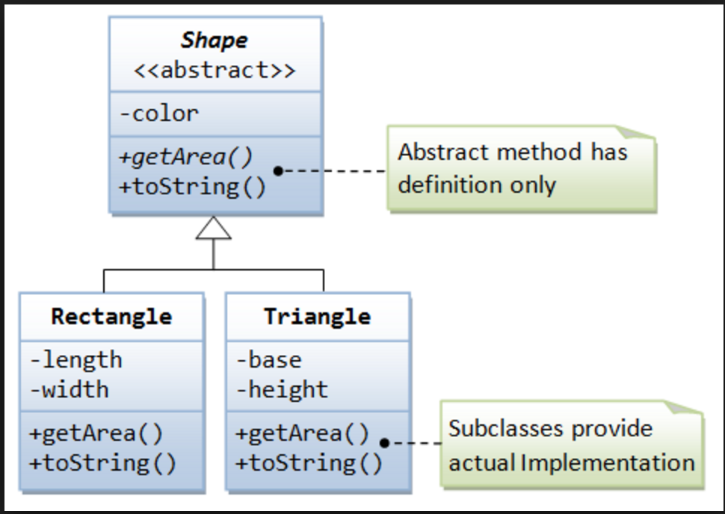
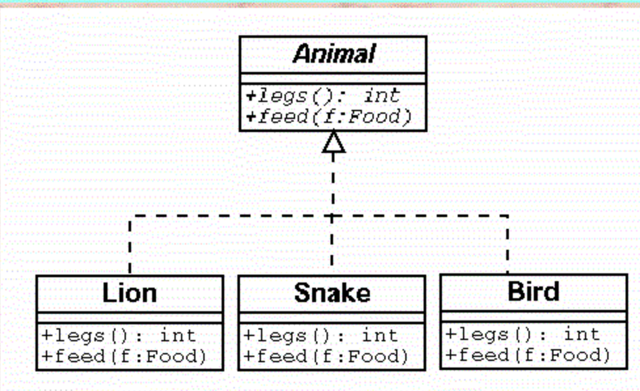
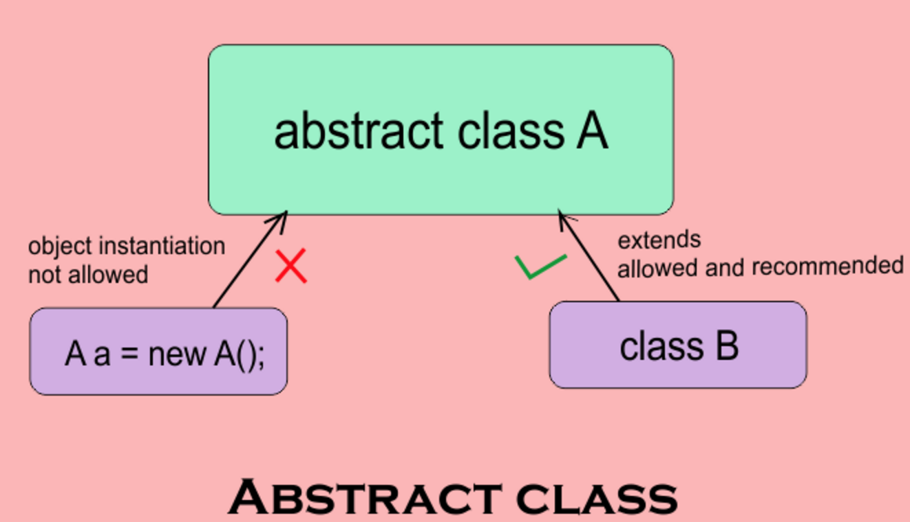
Abstract class
Typically, the base classes in an class hierarchy are abstract
Concepts (or classes) like Furniture, Vehicle, Engineer, Phone, Food, Drink, Animal are abstract
Keyword “abstract” is added in front of the abstract classes and they can’t be created using new
Abstract classes can have abstract methods – abstract methods only have method definition but no implementation in them

Slide 41
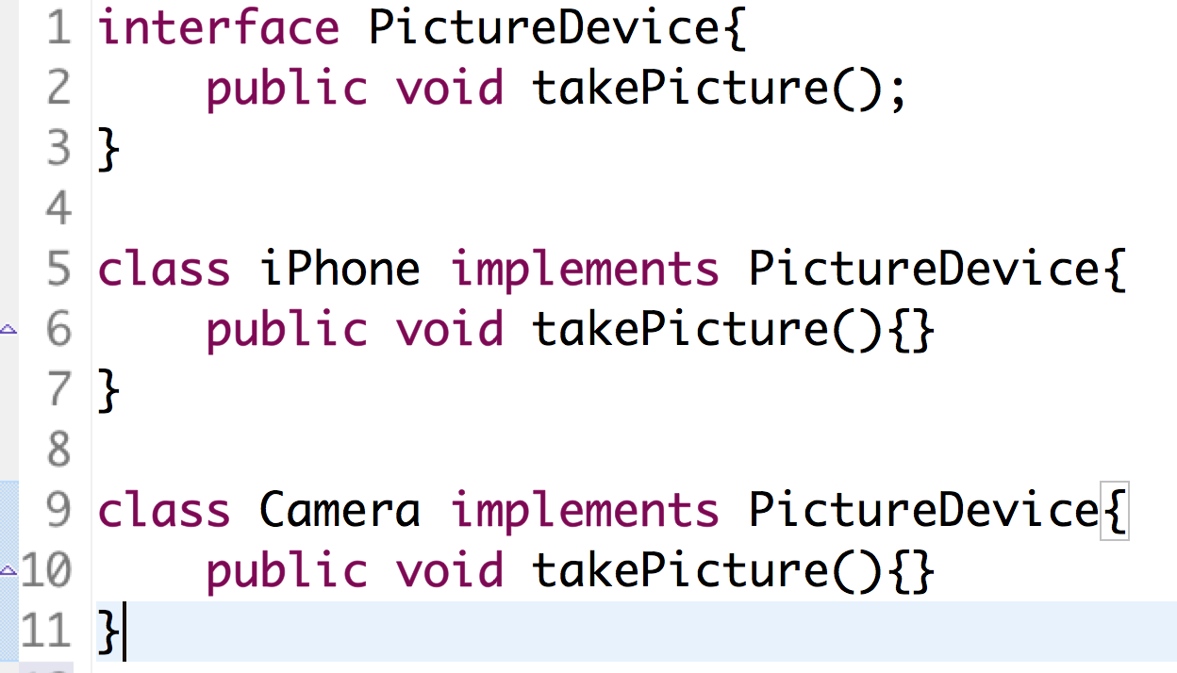
Interfaces
Interface is a contract for the Class and provides a specification for the users of this class.
Interface contains only method definitions but no implementations
Classes implementing an interface has to implement all the methods defined in the interface. Class implements interface using “implements” keyword
A class can implement multiple interfaces
A class can also implement a few methods of the interface but that class will be abstract and can’t be created using new

Slide 42
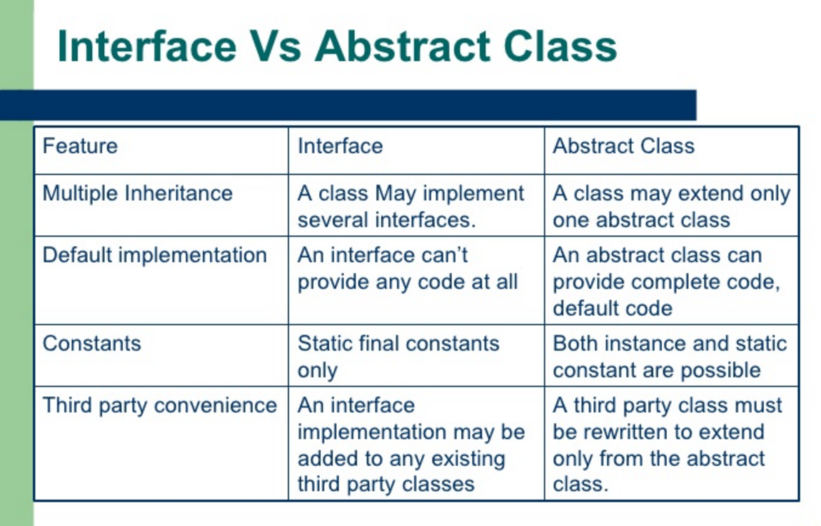
Interface Vs Abstract class

Slide 43
Packages
A package is a logical organization of related components (classes or interfaces)
Java classes can be logically organized into packages
Java Library provides standard packages like java.util, java.lang, java.io etc

Slide 44
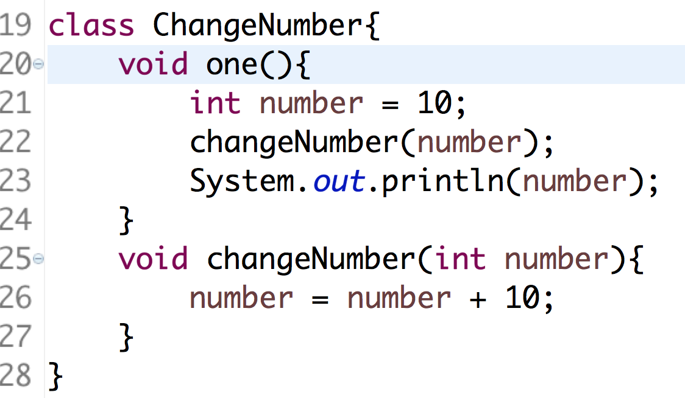
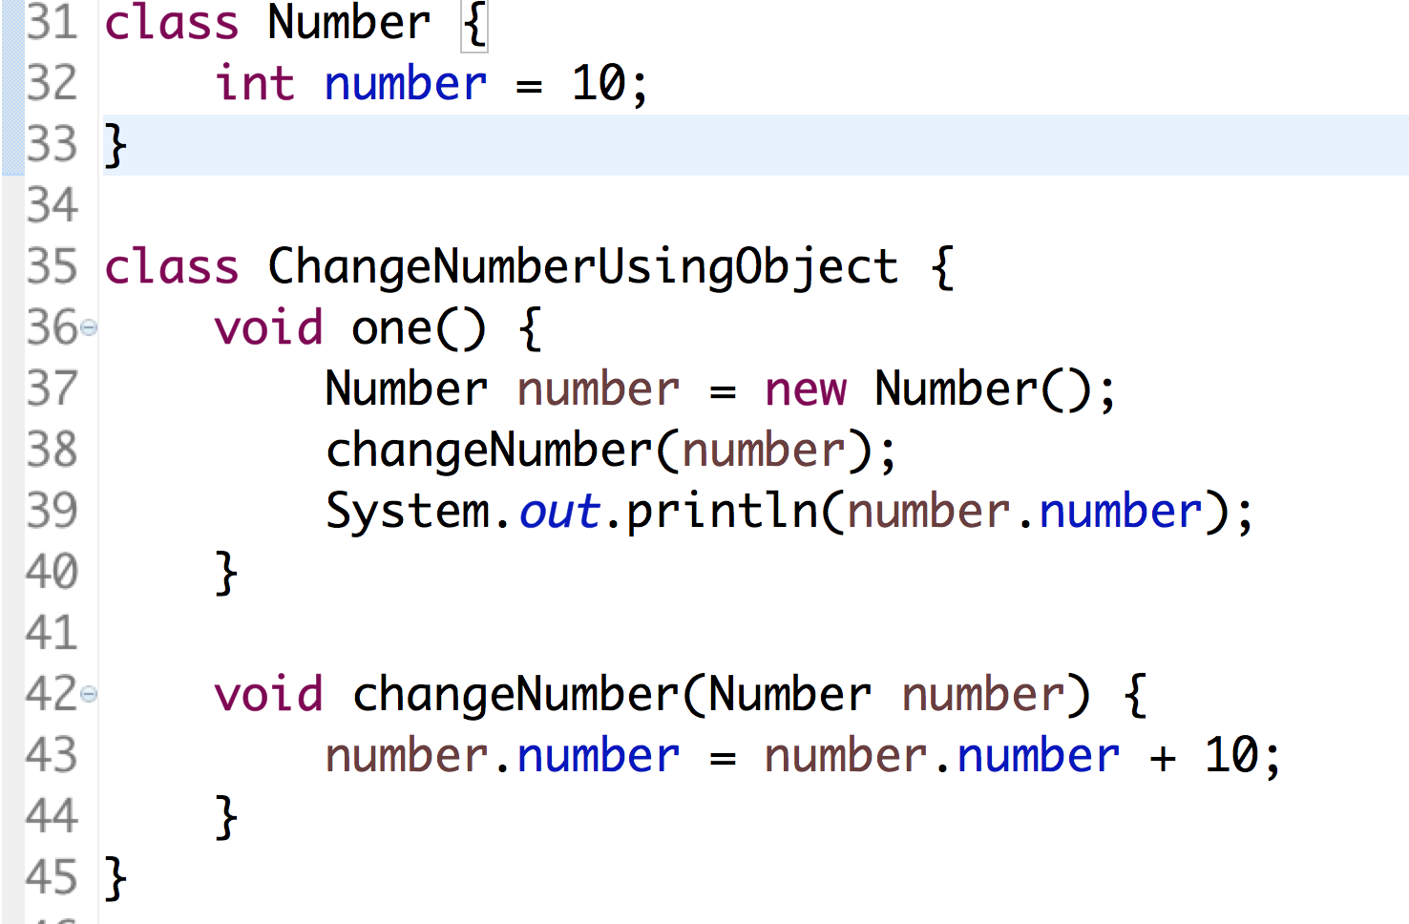
Pass by value and reference
Variables or primitive data types are passed by values in method calls
Objects are passed by references in method calls

Slide 45
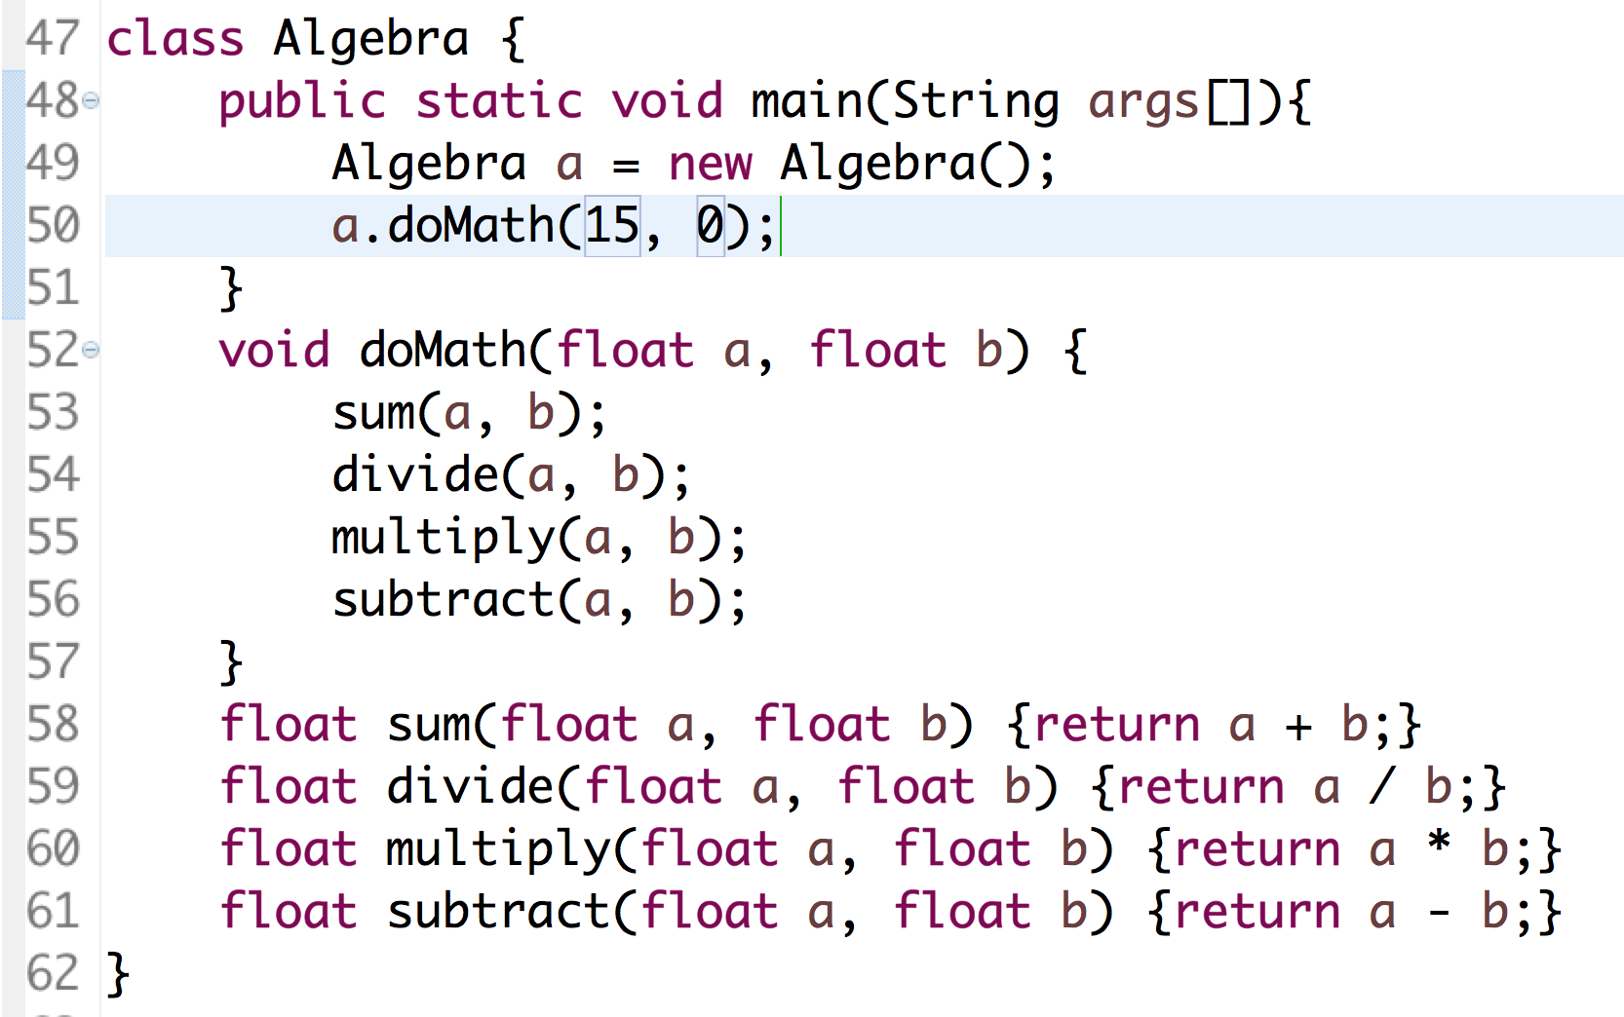
Exception Handling
Exception is a situation when something unexpected happens while executing code
Java provides mechanisms to handle exceptions

Slide 46
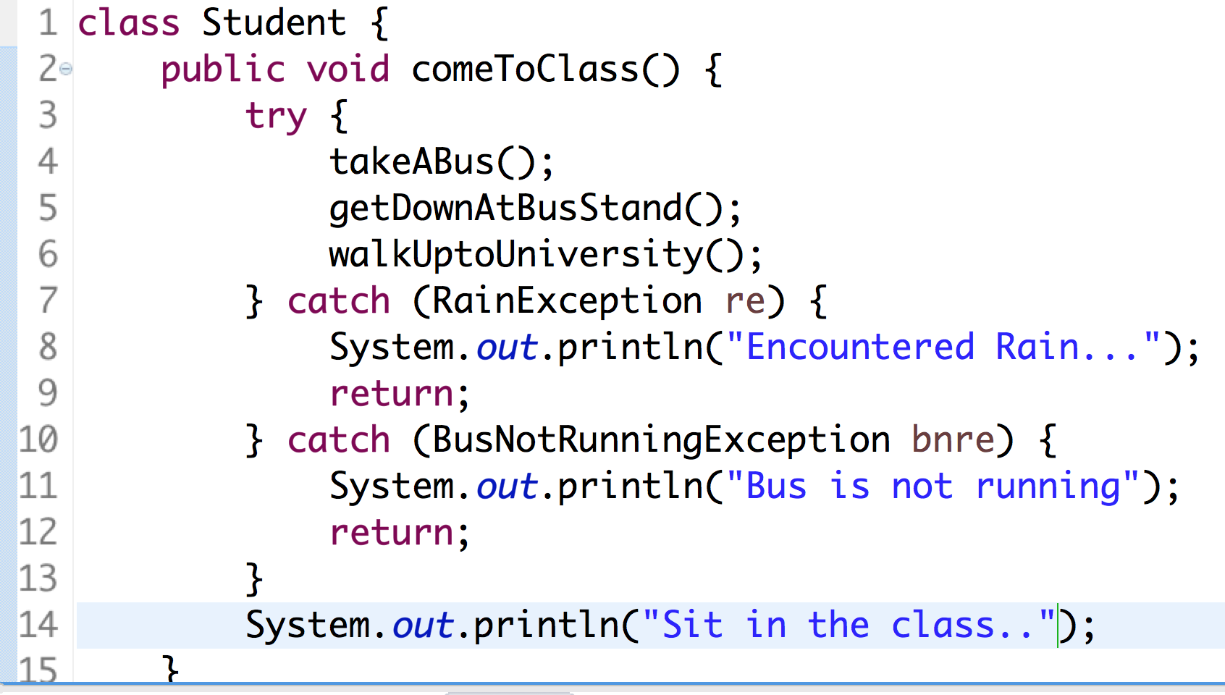
try, catch, throw, throws
Piece of code where you except a problem can happen should be surrounded with try and catch blocks

Slide 47
Maps
Map is a data structure (a type of Collection) to store/retrieve keys/values. This is like a dictionary
All the methods that are supposed to be implemented by a Map are defined in an interface named Map
Java provides different types of Map implementations
HashMap, HashTable, TreeMap, ConcurrentHashMap
Accessing elements defined in one of the above implementations is pretty fast. Java uses a concept of hashing and storing the elements in a bucket for faster retrieval
Accessing elements in the Array or a Collection is sequential and becomes slower when the size of array becomes longer where as time to access the elements in the Map is same irrespective of the number of elements in the Map.
The reason for faster access is, the lookup is done exactly on the bucket where an element is placed
Java (HashMap) uses object.hashCode() and runs a hash algorithm on this number to find the bucket where an element needs to be place

Slide 48
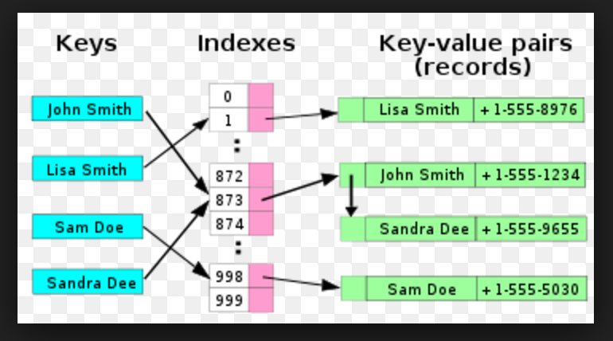
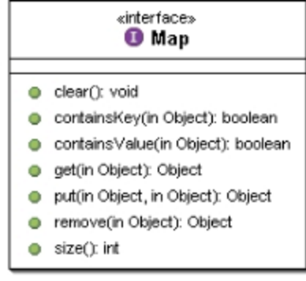
Map contd..

Slide 49
Threads
Performing operations concurrently (in parallel)
We can walk, talk, breathe, see, hear, smell... all at the same time
Computers can do this as well - download a file, print a file, receive email, run the clock, more or less in parallel….
How are these tasks typically accomplished?
Operating systems support processes
What’s the difference between a process and a thread?
Processes have their own memory space, threads share memory
Hence processes are “heavyweight” while threads are “lightweight”
Most programming languages do not allow concurrency
Usually limited to operating system "primitives" available to systems programmers
Java supports concurrency as part of language and libraries

Slide 50
An Overview of the Thread Methods
Thread-related methods
See API for more details (especially exceptions)
Constructors
Thread() - Creates a thread with an auto-numbered name of format Thread-1, Thread-2...
Thread( threadName ) - Creates a thread with name
run
Does “work” of a thread – What does this mean?
Can be overridden in subclass of Thread or in Runnable object (more on interface Runnable elsewhere)
start
Launches thread, then returns to caller
Calls run
Error to call start twice for same thread

Slide 51
Thread States: Life Cycle of a Thread
Born state
Thread just created
When start called, enters ready state
Ready state (runnable state)
Highest-priority ready thread enters running state
Running state
System assigns processor to thread (thread begins executing)
When run completes or terminates, enters dead state
Dead state
Thread marked to be removed by system
Entered when run terminates or throws uncaught exception

Slide 52
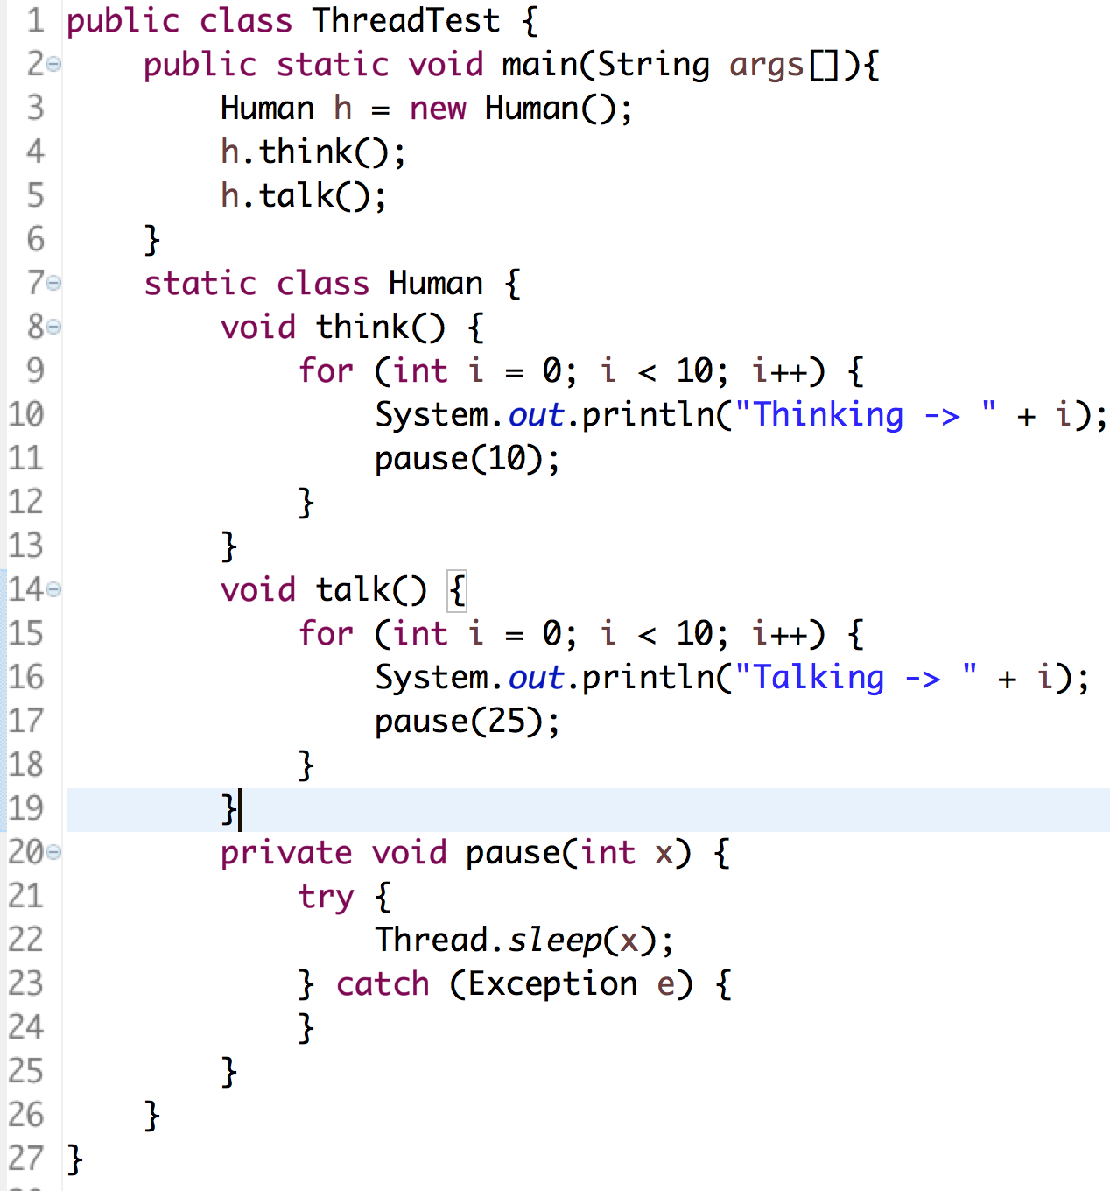
Java Program – without Thread

Slide 53
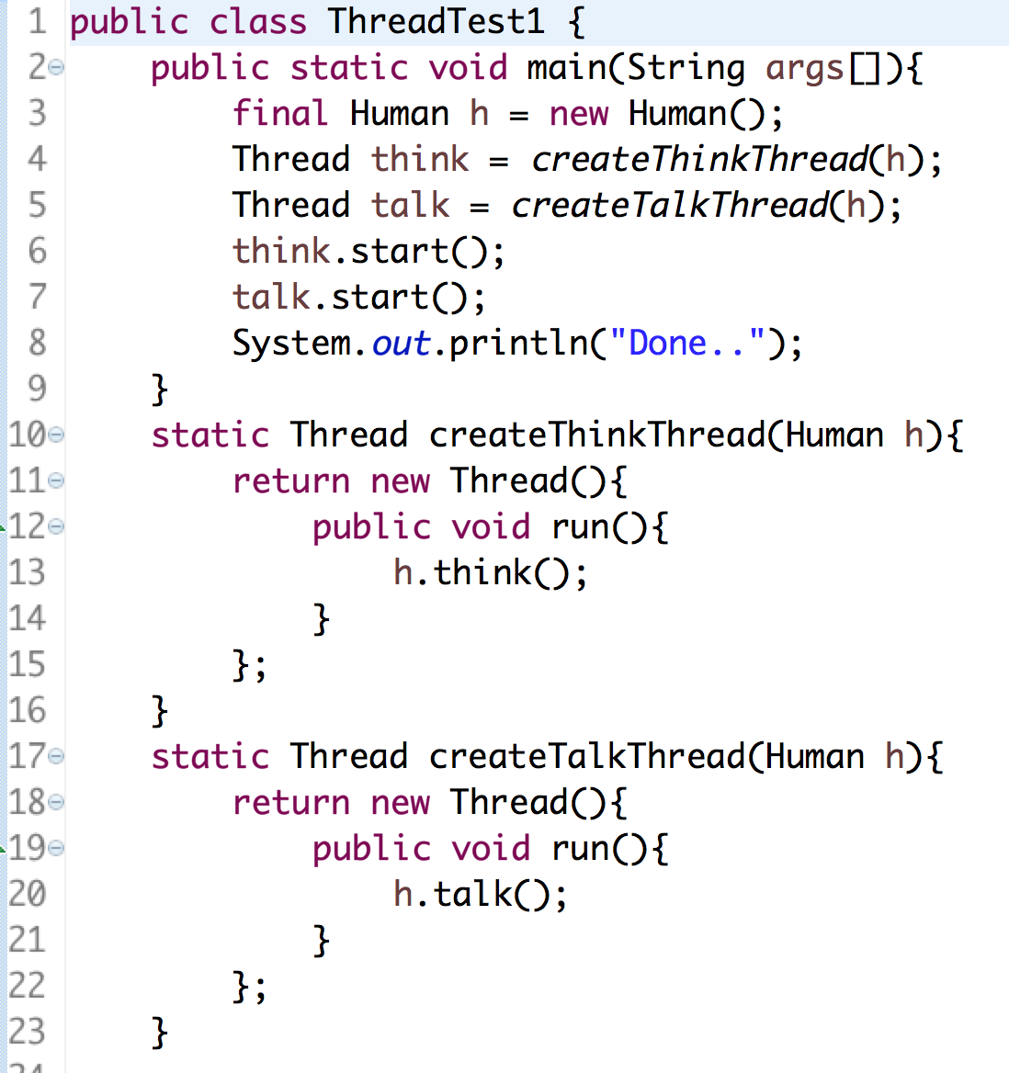
Java Program – with Threads

Slide 54
Thread Synchronization
Synchronization is a mechanism to control the flow of code when different threads are executing
Monitors
Object with synchronized methods
Any object can be a monitor
Methods declared synchronized
public synchronized int myMethod( int x )
Only one thread can execute a synchronized method at a time
Obtaining the lock and locking an object
If multiple synchronized methods, only one may be active
Java also has synchronized blocks of code

Slide 55
Runnable Interface
Java does not support multiple inheritance
Instead, use interfaces
Until now, we inherited from class Thread, overrode run
Multithreading for an already derived class
Implement interface Runnable (java.lang)
New class objects "are" Runnable objects
Override run method
Controls thread, just as deriving from Thread class
In fact, class Thread implements interface Runnable
Create new threads using Thread constructors
Thread( runnableObject )
Thread( runnableObject, threadName )

Slide 56
Wait and Notify
Waiting and Notification is a mechanism to pause and resume execution of Threads
This is needed for intra thread communication
For eg:- A professor asks a question to the students. He needs to wait till the Student responds and then professor can say whether the answer is right or wrong
Professor Thread is executing – Student thread has to wait
Professor Thread has to wait after asking a Question – Student Thread gets notified and answers the question
Professor gets notified after Student answers the question – Student Thread has to wait to hear the feedback from professor etc.

Slide 57
Runnable Interface
Java does not support multiple inheritance
Instead, use interfaces
Until now, we inherited from class Thread, overrode run
Multithreading for an already derived class
Implement interface Runnable (java.lang)
New class objects "are" Runnable objects
Override run method
Controls thread, just as deriving from Thread class
In fact, class Thread implements interface Runnable
Create new threads using Thread constructors
Thread( runnableObject )
Thread( runnableObject, threadName )

Slide 58
Wait and Notify
Waiting and Notification is a mechanism to pause and resume execution of Threads
This is needed for intra thread communication
For eg:- A professor asks a question to the students. He needs to wait till the Student responds and then professor can say whether the answer is right or wrong
Professor Thread is executing – Student thread has to wait
Professor Thread has to wait after asking a Question – Student Thread gets notified and answers the question
Professor gets notified after Student answers the question – Student Thread has to wait to hear the feedback from professor etc.

Slide 59
File (java.io.File)
File (java.io.File) is a class to manage Files on the File system
File f = new File(“/Users/dosapats/a.txt”);
f is a reference to a File named a.txt
File parent = new File(“a”);
File child = new File(parent,”b.txt”);
In the above code, child refers to a file named b.txt in a directory
File f = new File(“/Users/dosapats”);f.listFiles() will list all the files in the directory
All file related methods can be found in java.io.File class

Slide 60
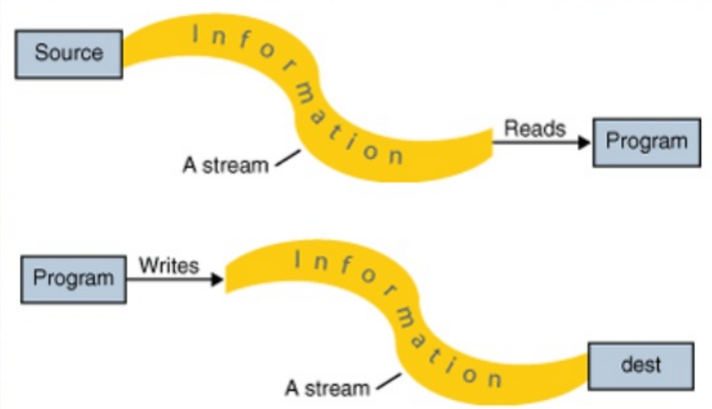
Streams
Stream is a channel through which data can be read or written
InputStream is a channel through which data can be read
OutputStream is a channel through which data can be written

Slide 61
Streams
File (java.io.File) is a class to manage Files on the File system
File f = new File(“/Users/dosapats/a.txt”);
f is a reference to a File named a.txt
File parent = new File(“a”);
File child = new File(parent,”b.txt”);
In the above code, child refers to a file named b.txt in a directory
File f = new File(“/Users/dosapats”);f.listFiles() will list all the files in the directory
All file related methods can be found in java.io.File class

